Slide 1

Docker

Slide 2

Agenda
Introduction
What is Docker?
Basic Commands
Docker Compose
Docker Network
References

Slide 3
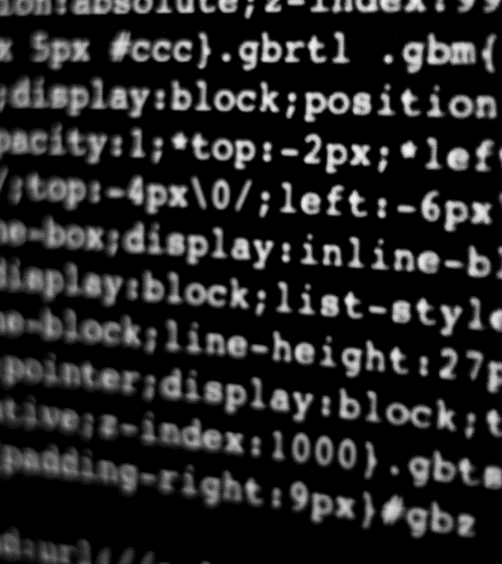
What is Docker?
Let’s Dive In

Slide 4

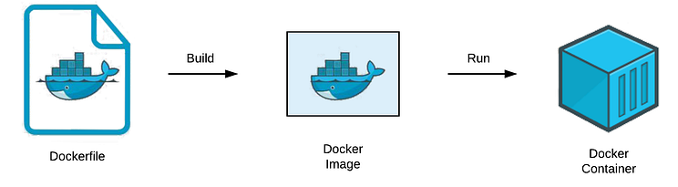
INTRODUCTION
What is Docker?
Docker is an open platform for developing, shipping and running applications.
Significantly, it reduces the delay between writing code and running it in production when compared to traditional virtual machines.
It involves Continuous Integration and Continuous Delivery.
The isolation and security let’s you run many containers simultaneously on a given host.
Docker helps us run and set up a development environment without needing to install all the dependencies because of the docker-compose.yml file.

Slide 5
INTRODUCTION
What is Docker?
Dockerfile
Dockerfile is nothing but a text document which contains all the commands that a user can call on the command line to assemble an image or we can say it contains instructions for building a Docker image.
Each instruction in the Dockerfile executes a command that adds files, installs software, or configures the environment.
It is the blueprint for creating a Docker image.
Common Instructions include:
FROM <image>: This specifies the base image to use for the docker image.
RUN <command>: This runs a command inside the container during the build process.
COPY <host-path> <image-path>: This copies files from the local file system to the docker image.
ENV <name> <value>: Set’s the environment variables in container.

Slide 6
INTRODUCTION
What is Docker?
Dockerfile
WORKDIR <path>: This set’s the working directory for subsequent commands in the dockerfile.
CMD ["<command>", "<arg1>"]: This specifies the command to run when the docker container starts.
ADD [OPTIONS]: Similar to copy, but can also extract files and download URL’s.
LABEL: Adds metadata to the image such as version, description, or maintainer information.
EXPOSE <port-number>: Informs docker that the container listens on the specified network ports at runtime. (This does not actually publish the ports)
ENTRYPOINT: Set’s the command that will always run when the container starts.

Slide 7
INTRODUCTION
What is Docker?
Docker Image
Docker image is just like a template to create a docker container. It includes everything needed to run a piece of software such as the application code, libraries, dependencies, environment variables, etc.
Docker images are built from Dockerfiles, and they are read-only templates used to create containers. Once an image is created, it can be reused, shared, and deployed across various environments.
An image is immutable meaning it cannot be changed once created.
Image is made up of different layers, with each layer representing a different instruction in the Dockerfile, which can help us reuse the resource, saving storage and building faster.
docker image history image_name : Let’s you see the layers in the image.

Slide 8
INTRODUCTION
What is Docker?
Docker Container
Docker Container is a running instance of a Docker image. It provides a lightweight, isolated environment where the application runs.
Containers are similar to virtual machines, but they are more lightweight because they share the host system's kernel rather than running a full operating system.
Containers can be created, started, stopped, and deleted quickly. They are designed to run applications and services temporarily.
Each container runs in its own environment, isolated from other containers and the host system, but it can communicate with them through networks.
Using build cache effectively lets you achieve faster builds by reusing results from previous builds and skipping unnecessary work.

Slide 9
INTRODUCTION
What is Docker?
Docker Volumes
Docker Volumes are a way to store and manage data used by docker containers.
When you run a docker container, by default any data created or modified inside the container is lost once the container stops or is removed.
Docker volumes help solve this problem by providing a separate storage area that containers can access even after they stop or are removed
By default the container stores it’s data in a SQlite database which is a relational database that stores all the data in a single file. There are 2 main types of volumes:
Named Volumes
Bind Mounts

Slide 10

Docker Basic Commands
Let’s Dive In

Slide 11

Steps to deploy a container
1) Create a file
2) Create a Dockerfile
3) Create a Docker image by running the following line in the terminal
docker build -t image_name .
4) Run the Container by running the following line in the terminal
docker run image_name
Push an image to docker hub
docker login -u user_name
docker tag imgname username/imgname:vername (Optional)
docker push username/imagename

Slide 12
Basic Commands
docker pull image_name : To pull image.
docker build -t image_name : build a docker image.
docker run image_name : To create a container.
-it : for interactive terminal
-d or --detach : for running the container in the background
--name : for naming the container
-p or --publish : for port mapping
-v volume_name:/path/to/container : for adding a volume
docker ps : To check running containers.
docker ps -a : To check all existing containers.
docker rm -f container_id : To remove a container.
docker images : To show list of exiting images.
docker rmi image_name : To remove an image.
docker stop/start image_name : To stop/start a container.
docker container commit -m “Add : To create a new image from a
Node” base-container node-base container’s current state.

Slide 13
Basic Commands
docker build . : Creates an image using the Dockerfile.
docker volume create volume_name : create a new volume.
docker volume inspect volume_name : Inspect details of the volume.
docker volume rm : To remove a volume.
docker volume prune : To remove all unused volumes.
To grant read/write access we can use :ro or :rw with the -v or --mount flag during container creation
docker exec used to run a command in a running container.
docker exec -ti db psql -u postgres
docker exec: This command runs a specified command inside an already running container.
-ti:
-t: Allocates a pseudo-TTY, which enables terminal interaction (so that you can see the command-line interface).
-i: Keeps STDIN open (interactive mode) so that you can interact with the container.
db: The name of the running container. In this case, the container is named db, which likely contains a PostgreSQL server.
psql: This is the PostgreSQL command-line client (interactive terminal) used to interact with PostgreSQL databases.
-u postgres: This specifies the user to connect to the PostgreSQL database as. In this case, it is using the default PostgreSQL admin user, postgres.

Slide 14

Docker Compose
LOOKING AHEAD

Slide 15

Docker Compose
Docker Compose is a tool that helps define and run multi-container Docker applications.
Using Docker Compose, you can configure multiple containers to work together, defining their services, networks, and volumes in a single docker-compose.yml file.
It allows you to easily manage complex applications composed of multiple services, such as a web server, database, cache, and so on.
Docker helps us run and set up a development environment without needing to install all the dependencies with the help of the docker-compose.yml file.
Docker Compose Commands:
docker-compose up : Build, create, start and attach to containers for a service
docker-compose down : stop and remove containers, networks, images and volumes
docker compose watch : Used for setting up a system where docker automatically detects changes to your code and restarts itself during development.
docker compose logs : To view logs from your services.

Slide 16
Docker Compose
docker-compose build : Used for build or rebuilding the docker images as specified in the docker-compose.yml file.
docker-compose start/stop : To start or stop containers.
docker-compose ps : Displays the status of all the services.
docker-compose config : Used to validate and view the configuration and allows you to see what the final configuration will look like after processing.
docker-compose pull : Used to download the images specified in the docker-compose.yml file from Docker Hub to your local machine.
docker-compose push : Used to upload your local images to a Docker hub.

Slide 17

Docker Network
LOOKING AHEAD

Slide 18

Docker Network
Docker networking allows Docker containers to communicate with each other, as well as with the outside world, in a flexible and controlled manner.
Two ways to put a container on a network:
Assign the network when starting the container.
Connect an already running container to a network.
Default Networks:
Bridge: The default network for containers. Containers launched without specifying a network are connected to this network.
None: Containers connected to this network have no network interface. it’s useful for isolating containers from any network.
Host: Containers use the host's network stack directly, which can improve performance but comes with security and configuration trade-offs.
Docker Network Commands:
docker network create network_name : To create a new network.
docker network ls : List all existing networks.

Slide 19
Docker Network
docker network connect network_name container_name : Connects a running container to an existing network.
docker network disconnect network_name container_name : Disconnects a running container from an existing network.
docker network inspect network_name : Provides detailed information about a network, including connected containers and their IP addresses.
docker network rm network_name : Deletes a network only if no containers are attached to it
docker network prune : Removes all unused networks.
.dockerignore is a text file used by Docker to exclude files and directories from the context that is sent to the Docker daemon during the build process. It can be used to decrease the size and increasing processing speed.
docker scan image_name : Used to perform a security scan of a specified Docker image

Slide 20

References
https://docs.docker.com/get-started/docker-overview/
https://docs.docker.com/get-started/workshop/
https://docs.docker.com/reference/dockerfile/
https://www.youtube.com/watch?v=8BpCXHJFbQE&ab_channel=ProgrammingKnowledge
https://www.youtube.com/watch?v=pg19Z8LL06w&ab_channel=TechWorldwithNana
https://medium.com/techmormo/what-is-docker-compose-with-demo-a37568b45200

Slide 21
THANK YOU

